Slide 1
Immersive Data Analysis – Project 1
Allende
Sikhote-Alin
Akaba
Piancoldoli
Bethlehem
….plus over 45,000 more in this Data Set!

Slide 2
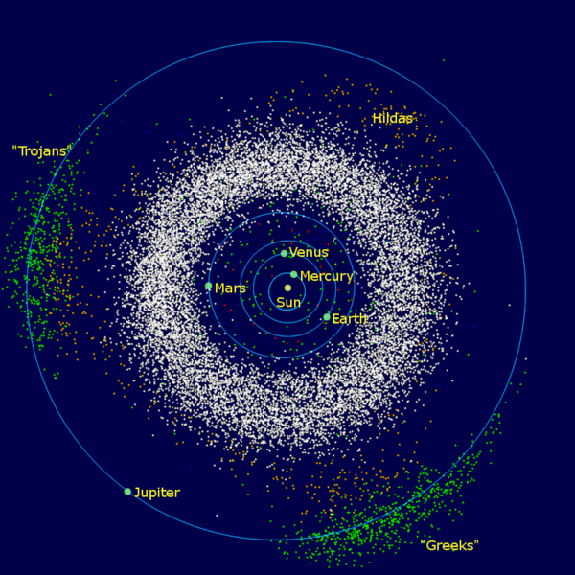
Asteroids?
C-type – Carbonaceous chondrite meteorites – clay & stony silicates - %75, outer
S-type – Silicaceous meteorites – nickel iron, green, 17% - inner
M-type – Iron meteorites., nickel iron, redish, maj of remainder, middle
(V-type – Vesta, 1807, 1 of 16, 329 miles in dia)
Notes:
Carbonaceous chondrite types – Among the stony meteorites are the chondrites which contam small round spheres called chondrules. These small spherules are principally made up of olivine and pyroxene (minerals made up of Mg, Fe and silicate) The carbonaceous chondrites are composed not only of inorganic minerals but have a high abundance of carbon.
Stony meteorites, which are the most abundant kind of meteorite, are divided into two groups: chondrites and achondrites. Chondrites are physically and chemically the most primitive meteorites in the solar system.
HED meteorites are a clan (subgroup) of achondrite meteorites. HED stands for "howardite–eucrite–diogenite". These achondrites came from a differentiated parent body and experienced extensive igneous processing not much different from the magmatic rocks found on Earth and for this reason they closely resemble terrestrial igneous rocks

Slide 3
About this file (.csv)
This dataset includes the following fields:
name: the name of the meteorite (typically a location, often modified with a number, year, composition, etc)
id: a unique identifier for the meteorite
nametype: one of: -- valid: a typical meteorite -- relict: a meteorite that has been highly degraded by weather on Earth
recclass: the class of the meteorite; one of a large number of classes based on physical, chemical, and other characteristics (see the Wikipedia article on meteorite classification for a primer)
mass: the mass of the meteorite, in grams
fall: whether the meteorite was seen falling, or was discovered after its impact; one of: -- Fell: the meteorite's fall was observed -- Found: the meteorite's fall was not observed
year: the year the meteorite fell, or the year it was found (depending on the value of fell)
reclat: the latitude of the meteorite's landing
reclong: the longitude of the meteorite's landing
GeoLocation: a parentheses-enclose, comma-separated tuple that combines reclatand reclong
“isnull”
name 0
id 0
nametype 0
Recclass 0
mass 131
fall 0
year 288
reclat 7315
reclong 7315
GeoLocation 7315
https://www.kaggle.com/nasa/meteorite-landings

Slide 4
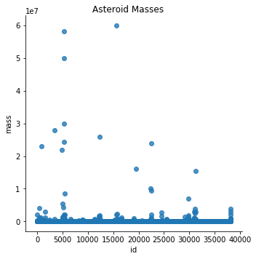
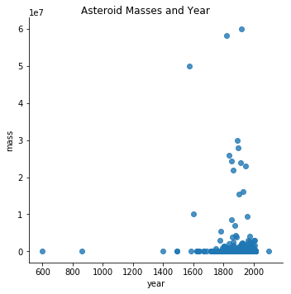
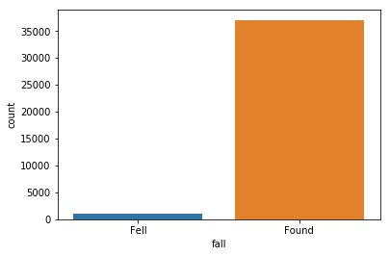
Asteroids - Python

Slide 5
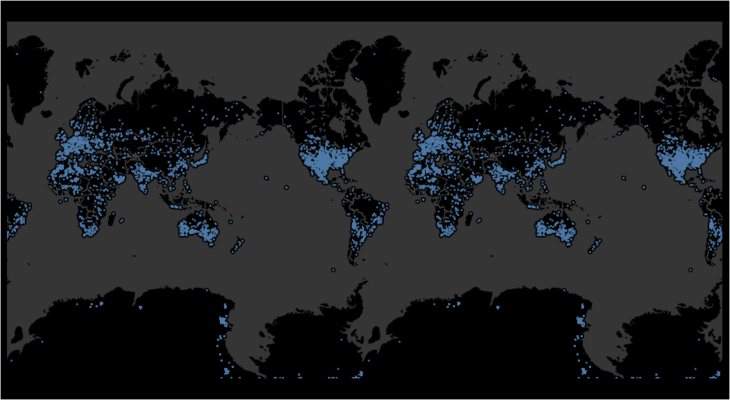
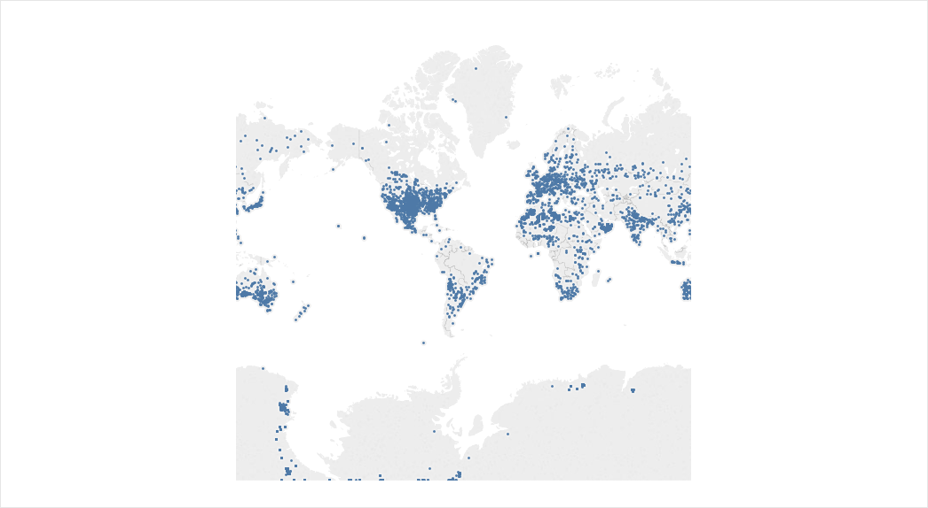
Asteroids - Tableau

Slide 6
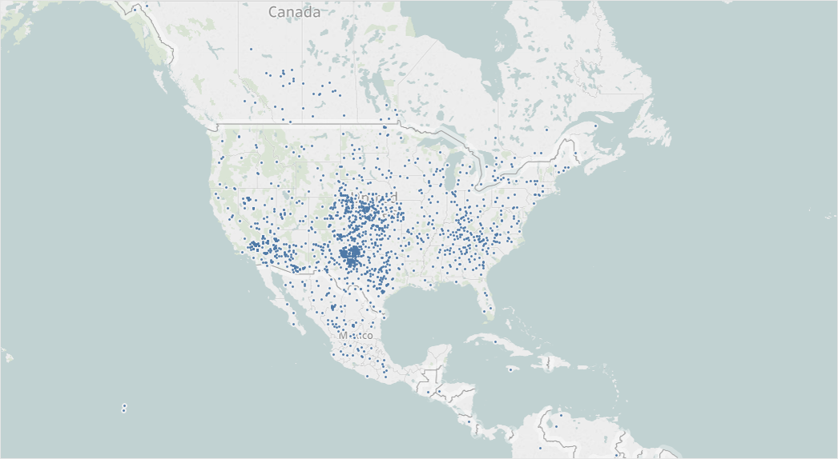
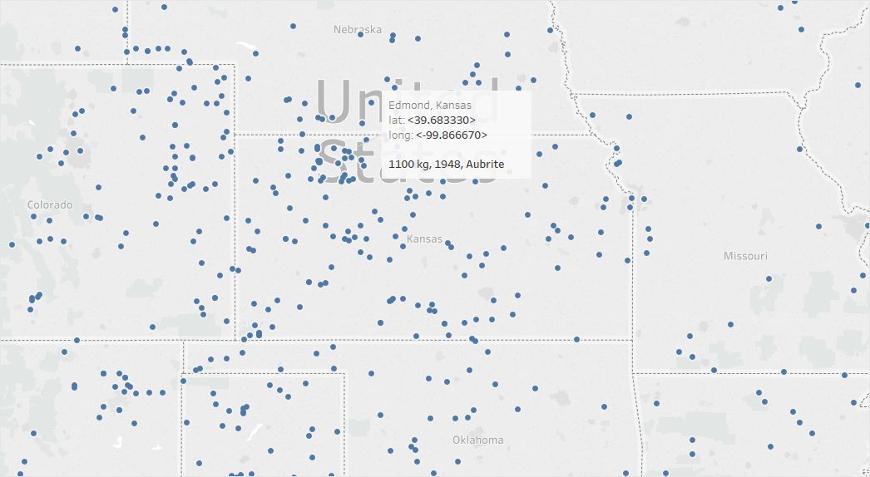

Slide 7
Some Lessons… Highlights…
Too large of data sets – ‘chunks’
“Making it fit” – distribution curve
Fiddled w/PDF - scraping
Writing new data *.csv
Geopandas…

Slide 8
Meteorite Trivia
Most expensive asteroid - The Fukang Meteorite - €1.7 million
How many hit earth’s atmosphere – 500 a day, 30 hit the earth per year
Smallest size asteroid to hit earth? Marble
Speed? 25,000 to 168,000 mph
What killed the dinosaurs? 6.8 to 50.3 mile dia - Chicxulub crater, MX
Ceres – ¼ the moon, spherical

Slide 9
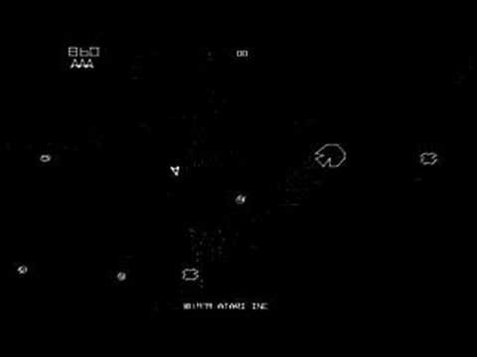
Atari 1979

